Slide 1

Lending Club Case Study
Priyanka Reddy Aguduri

Slide 2
Objective:
Lending Club company is the largest online loan marketplace, facilitating personal loans, business loans, and financing of medical procedures.
Like most other lending companies, lending loans to ‘risky’ applicants is the largest source of financial loss (called credit loss)
Company wants to understand the driving factors (or driver variables) behind loan default, i.e. the variables which are strong indicators of default. The company can utilize this knowledge for its portfolio and risk assessment.
Identification of such applicant's using EDA is the aim of this case study.

Slide 3
Problem Statement:
Identification of driving factors (or driver variables) behind loan default, i.e. the variables which are strong indicators of default. So that the company can utilize this knowledge for its portfolio and risk assessment.

Slide 4
Analysis Approach :
Importing the data and gaining knowledge on the data by referring Data Dictionary.
Removing and fixing all the null/Unnecessary columns and rows by checking the impact on analysis, correcting datatype and removing outliers
Analyzing the continuous data columns with respect to the categorical Variable
Analyzing the two variables to determine relationships between them.
Analyzing all the plots and providing the recommendations of which columns are driving factors for defaulters
Data Understanding
Data Cleaning
Univariant Analysis
Analyzing each column by plotting the distributions of each column
Segmented Univariant Analysis
Bivariant Analysis
Recommendation

Slide 5
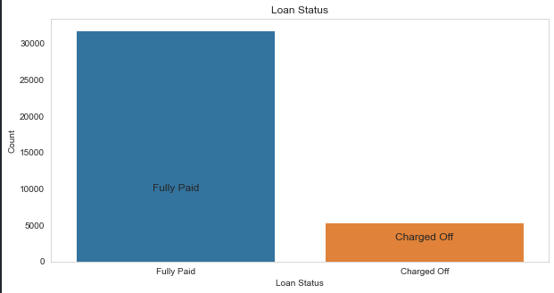
Analysis : Loan Status
Observation:
The number of charged off loan is much smaller(14.5%) of Total count.

Slide 6
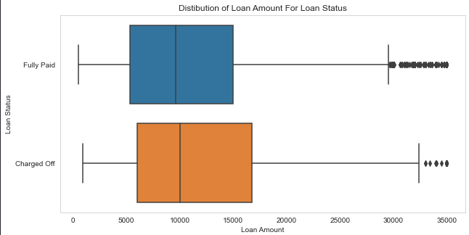
Analysis : Loan Amount
Observation :
Loan amount varies from 500 to 35000 with a median of 10000.
Larger the loan, higher the chance of defaulting.

Slide 7
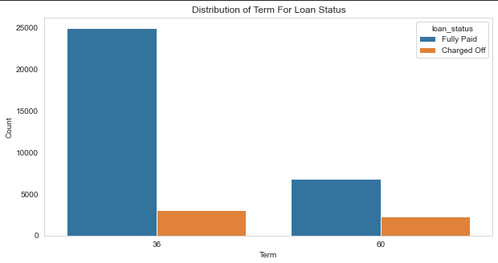
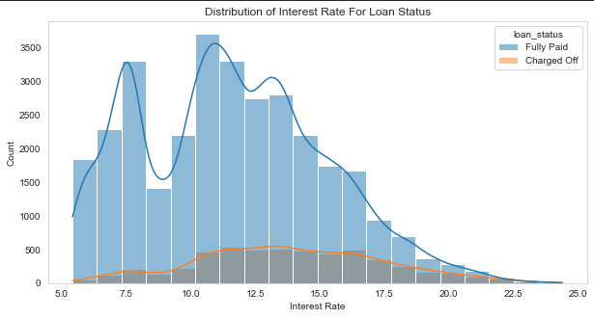
Analysis : Term and Interest Rate
Observation : The loan’s taken for 36 months term are much more than 60 months and have lower chance of defaulting.
Observation : The count of loan taken varies with interest rate showing peak around in 5-15 bracket. Chance of defaulting increases with the increase in interest rate.

Slide 8
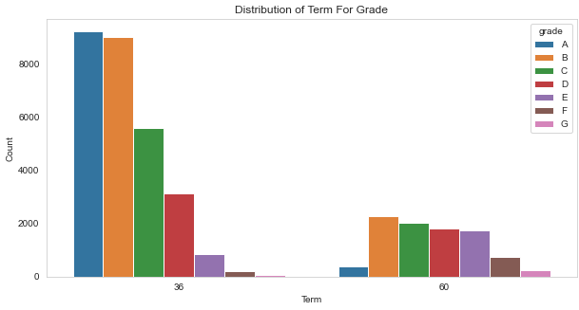
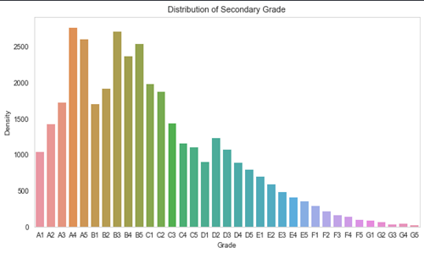
Analysis : Grade and Sub-Grade
Observation : The loan approved are majorly of higher grade as they are of low risk thus low chance of defaulting. 60 months term loans have larger number of lower grade loans with high risk of defaulting
Observation : This provides more insight that the loans within grade are more skewed towards lowered sub grades.

Slide 9
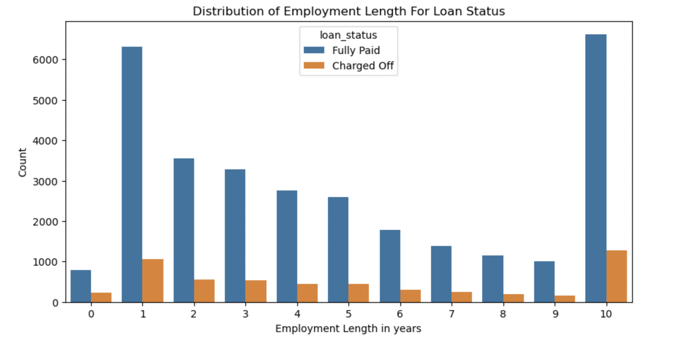
Analysis : Employment Length
Observation:
Majority of borrowers having 1 year / 10+ years of experience has highest number of defaulted loan.

Slide 10
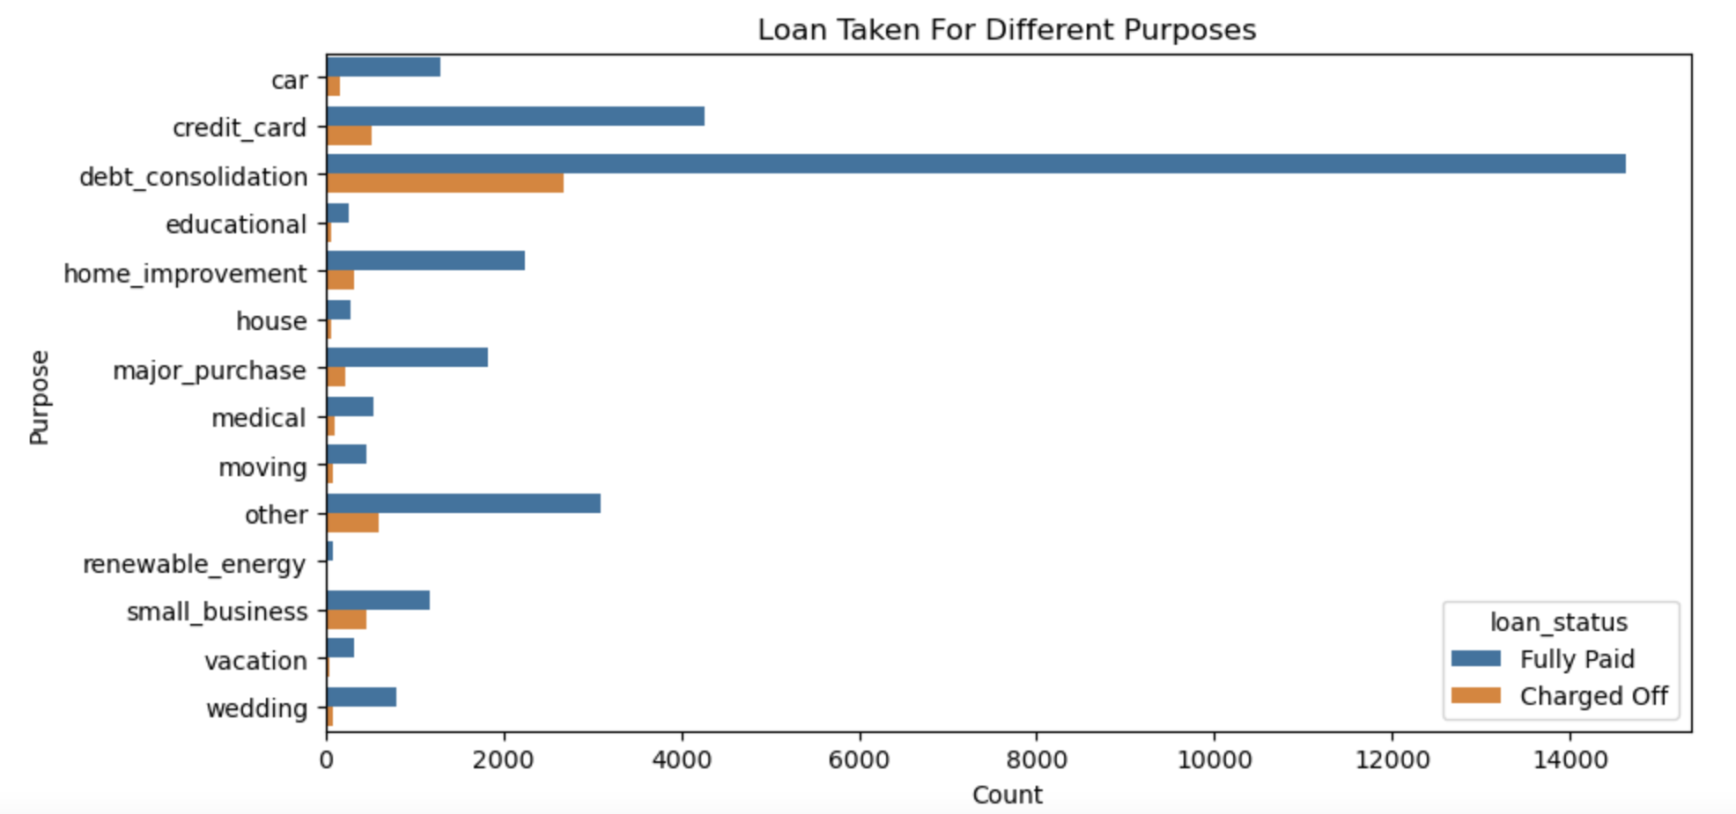
Analysis : Purpose
Observation:
Debt Consolidation is the most popular loan purpose and has highest number of fully paid loan and defaulted loan.

Slide 11
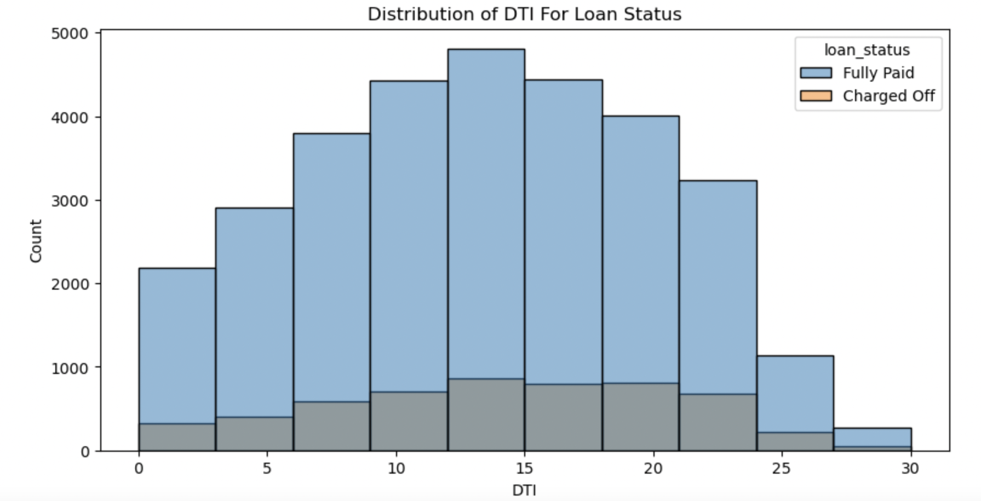
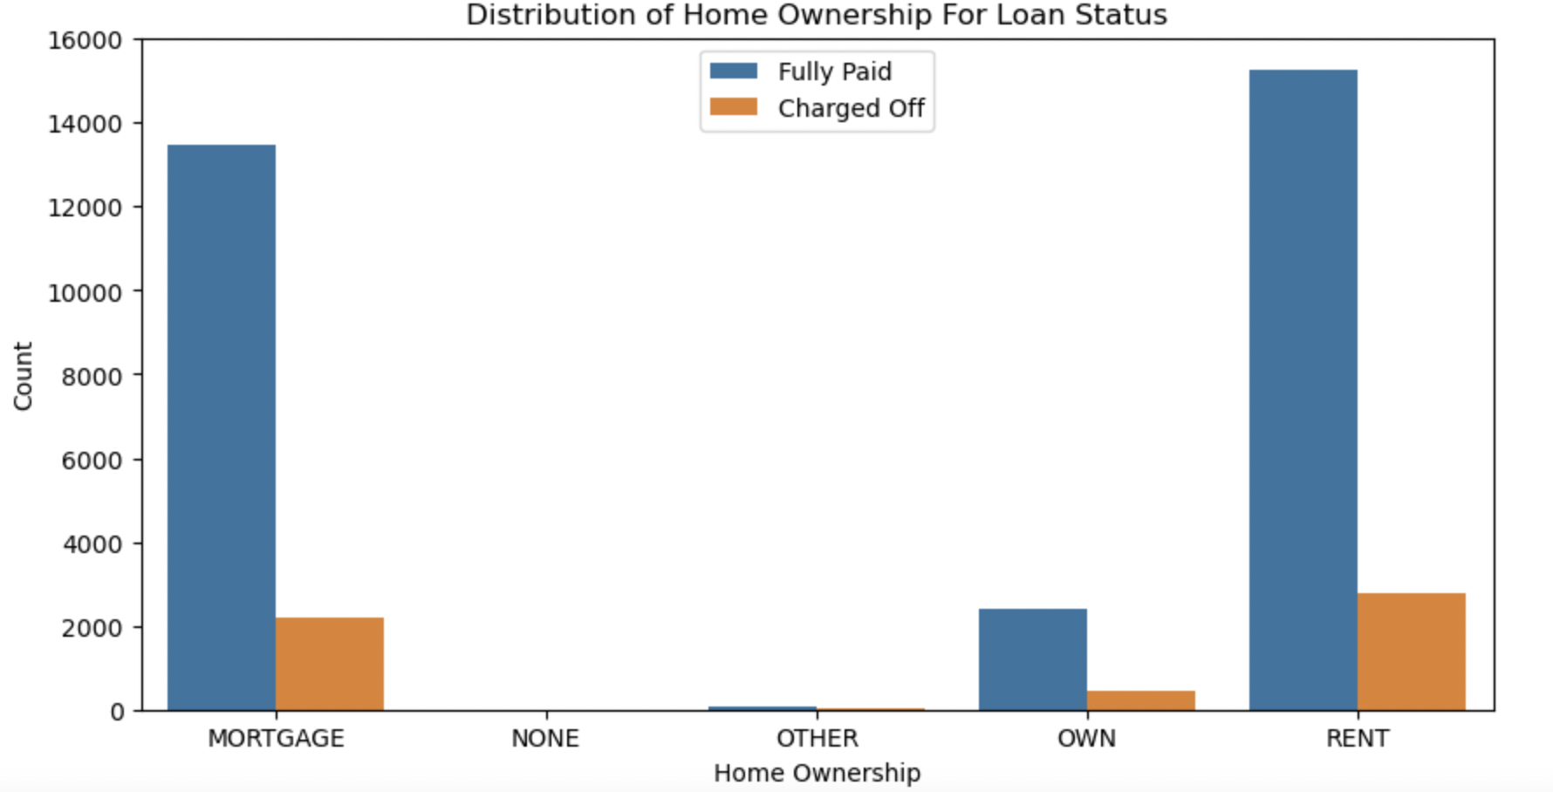
Analysis : DTI and Home Ownership
Observation : The large percentage of borrowers have a large Debt to Income ratio which shows that lending to such borrowers can be very risky.
Observation : Majority of borrowers are lacking ownership of any property and are on rent or mortgage are have a higher chance of defaulting.

Slide 12
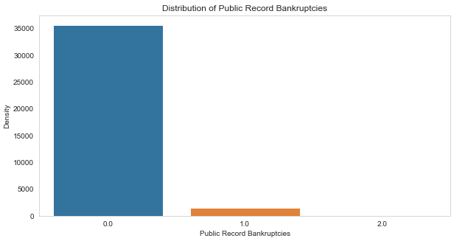
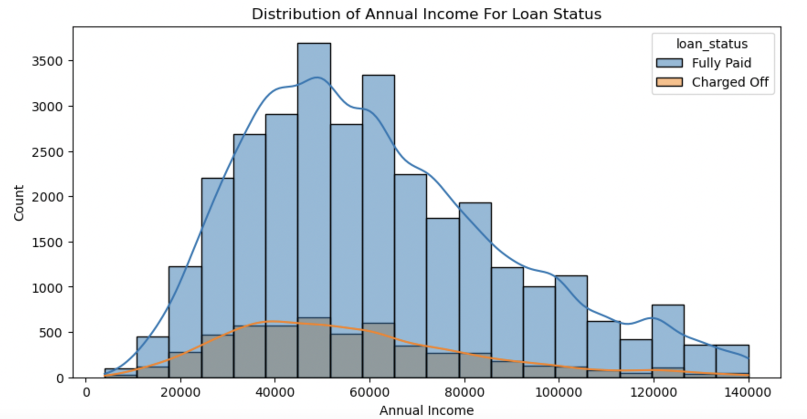
Analysis : Annual Income and Bankruptcy
Observation : The Majority of borrowers have low annual income compared to rest and borrowers having income lower than 50k has higher chance of defaulting.
Observation : Majority of borrowers have no record of declaring bankruptcy.

Slide 13
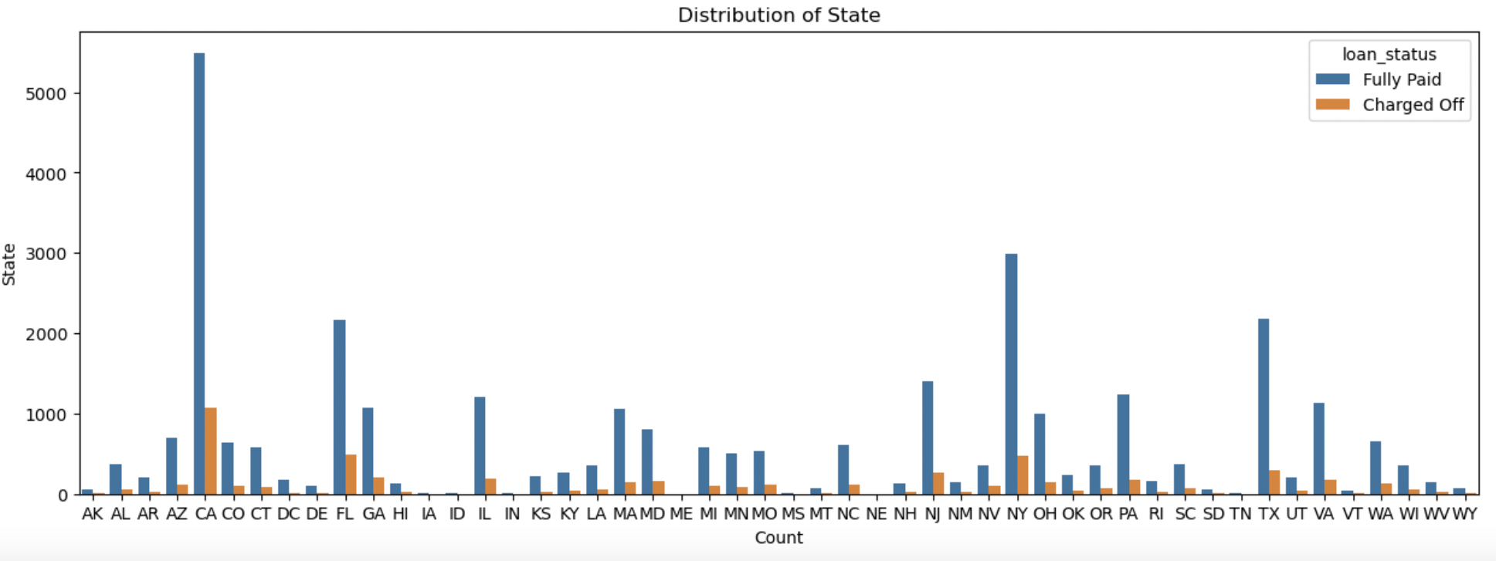
Analysis : State
Observation:
For large metropolitan cities we see large number of loans, with higher number of defaulted loans like California, New York, Texas, Florida but have a lower chance of defaulting.

Slide 14
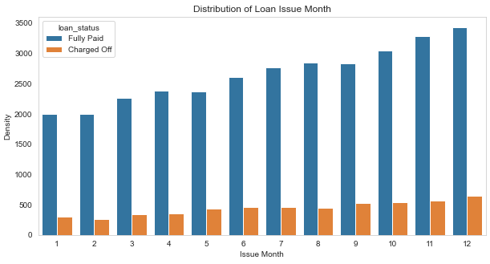
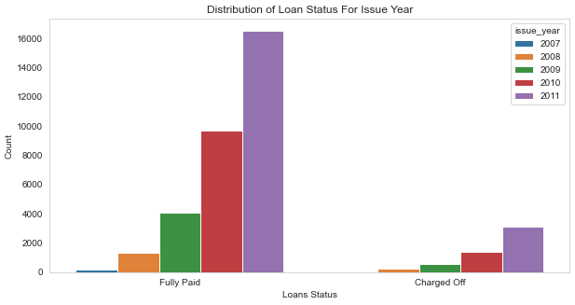
Analysis : Loan Trend over years
Observation : We see a gradual increase in loan taken through the year, with lesser defaulting rate in April ,August, December quarter wise and better more late in year.
Observation : With each passing year loan taken are increasing exponentially which indicate we are seeing large increase in DTI ratio and decrease in defaulting rate.

Slide 15
Recommendations:
Major Driving factor which can be used to predict the chance of defaulting and avoiding Credit Loss:
1. DTI
2. Grades
3. Verification Status
4. Annual income
5. Pub_rec_bankruptcies
Other considerations for 'defaults' :
1. Burrowers not from large urban cities like California, new york, texas, florida etc.
2. Burrowers having annual income in the range 50000-100000.
3. Burrowers having Public Recorded Bankruptcy.
4. Burrowers with least grades like E,F,G which indicates high risk.
5. Burrowers with very high Debt to Income value.
6. Burrowers with working experience 1 and 10+ years.

